Slide 1


Solar
Alliances
Expand your Horizon
Final Delivery

Slide 2


Personal introduction
Leon Micheel-Sprenger
Sofia Ferreira

Slide 3
Introduction to the Game
Title: Solar Alliances
Genre: Strategy & Management
Art: 2D
Platform: Computer Browser
Gametype: Multiplayer Game
Audio:
Subtle Space background sound within main Menu
Sound Effects and voice messages for actions taken by player

Slide 4
Game Objective
The player is the commander of a space station associated to one of three factions with a fleet of different spaceships at his/her disposal.
The player can:
Carry out Single Player Missions with his Fleet
Upgrade his/her Space station
Join others on Multiplayer Missions
Trade with his/her respective Faction
Goal:
The goal for the player is the expansion of his space station to unlock new ships and go on bigger, exciting solo or multiplayer missions

Slide 5
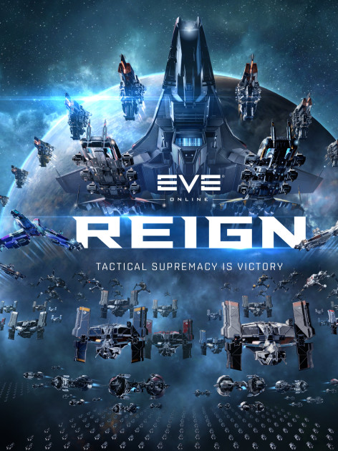
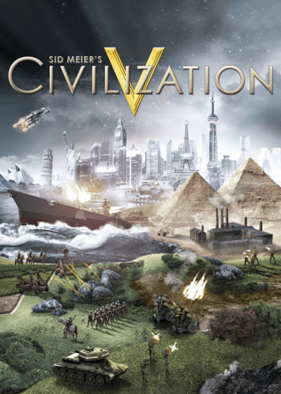



It is the year of 2350. Humankind has evolved and expanded its habitat across the solar system. The formation of new political systems in the system creates a call for new leaders, who must carry the responsibility of an entire civilization on their shoulders. Will you be one of those leaders?
Inspiration

Slide 6
Lets jump into the Game…
Notes:
Game Presentation Script:
1) Show the Register process of new player and initial state
2) Explain the functionalities of the game on the interface and how the game works
3) login to medium player (Player 2 - 123) and show intermediate state of game.
4) accept ice mining mission (mining ship)
5) Try committing to Great mining alliance (does not work because of mining ship blocked)
6) Build Mining ship in Ship fleet.
7) contribute to great mining alliance
show submission state of the mission
8) upgrade storage to store the incoming ore of the multiplayer mission
9) login to Leon1 (Password)
10) show advanced state of the game. (have a couple solo and multi missions running already.
11) Contribute to the Great Mining Alliance and show the running mission state.
12) Accept another solo mission and show list of running.
13) have one solo mission finish within the last time to show message.

